Slide 1

Dimensionality Reduction

Slide 2

Why do we care?The Curse of Dimensionality
Features are good right? We have more data, whats the problem?
Lets look at it this way, suppose we have a problem where our Y has three classes, and we have one feature with 10 observations.
We can easily plot this one a line:
What we have done is to divide the feature space into uniform bins and to predict the class we compute the ratio of examples for each class at each bin and for a new example, choose the predominant class in its bin.

Slide 3
Curse of dimensionality
After doing this, we notice that there exists too much overlap among the classes, so we decide to incorporate a second feature to try and improve separability.
This raises the number of bins from 3 (in 1D) to 3² = 9 (in 2D)
So, do we maintain the density of examples per bin or do we keep the number of examples had for the one-dimensional case?
That is, do we go out and fetch data and maintain the density of examples from 9 (in 1D) to 27 (in 2D)?
Or Choosing to maintain the number of examples results in a 2D scatter plot that is very sparse.

Slide 4
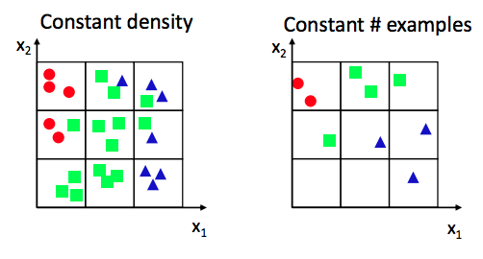
Which one?

Slide 5
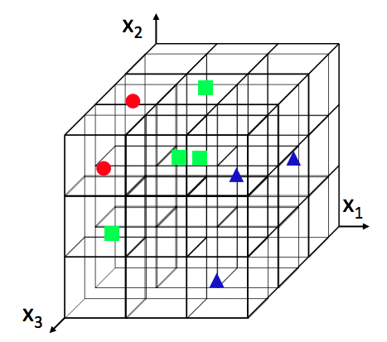
Lets try 3-Dimensions!
Moving to three features makes the problem worse – The number of bins grows to 3³ = 27 – For the same density of examples the number of needed examples becomes 81 – For the same number of examples, the 3D scatter plot is almost empty.

Slide 6
Practical implications
We could see in our 2 dim representation that some quadrants were empty. This means there were no observations that fell in that space. This was even more true for the 3 dim example.
A lot of the methods we use (Logistic, Naive Bayes, LDA, Decision Trees) count the frequency of classes per feature (e.g how many people who defaulted have incomes above $10,000).
If we have no observations in that space, how can we accurately predict for all possible values of X. Even if we had one or a few observations, the variance would be extremely high resulting in large error.
Sure, there are approaches where less susceptible to the curse of dimensionality (eg. KNN) but the problem still exists!

Slide 7
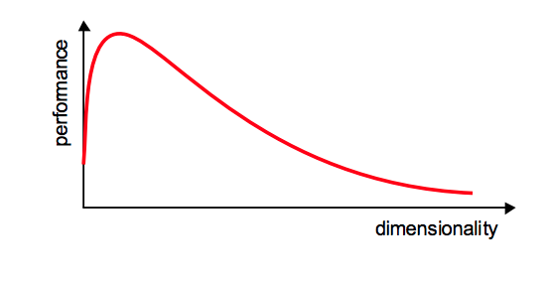
Practical implications
So what are the practical implications? For a given sample size, there is a maximum number of features above which the performance of our classifier will degrade rather than improve – In most cases, the additional information that is lost by discarding some features is (more than) compensated by a more accurate mapping in the lower-dimensional space.

Slide 8
How can we tackle this problem?
Option 1: Use domain knowledge to remove irrelevant features.
Option 2: Feature Extraction. Here we are trying to find a mapping 𝑦 = 𝑓 (𝑥) : 𝑅^{𝑁} → 𝑅^{𝑀} with 𝑀 < 𝑁 such that the transformed feature vector 𝑦 ∈ 𝑅^{𝑀} preserves (most of) the information or structure in 𝑅^{𝑁}
Lets focus on Option 2. Feature extraction techniques are grouped into two categories:
Signal representation: The goal of the feature extraction mapping is to represent the samples accurately in a lower-dimensional space
Signal Classification: The goal of the feature extraction mapping is to enhance the class-discriminatory information in the lower-dimensional space

Slide 9
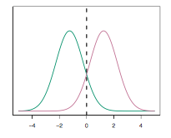
LDA: Signal Classification (Supervised dim. reduction)
LDA seeks to reduce dimensionality while preserving as much of the class discriminatory information as possible.
Previously, we saw that LDA discriminates on the basis of the multivariate gaussian distribution of the observations per class (P(X|Y)).
In order to use LDA as a dimensionality reduction technique, we seek to maximize the difference between distributions, so we have max separability.
Maximize the separation here

Slide 10
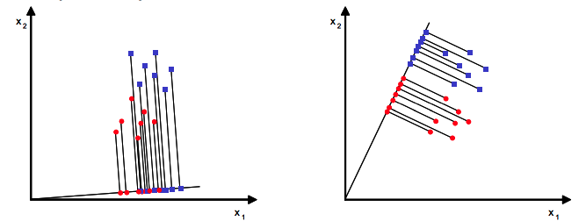
Discrimination
– Assume we have a set of D-dimensional samples {𝑥₁ , 𝑥₂ , … 𝑥_{N}} 𝑁₁ of which belong to class 𝜔₁, and 𝑁₂ to class 𝜔₂
– We seek to obtain a scalar 𝑦 by projecting the samples 𝑥 onto a line (THINK OLS, THIS IS THE VECTOR INTERPRETATION)
– Of all the possible lines we would like to select the one that maximizes the separability of the scalars
Notes:
We will project the input data to a linear subspace consisting of the directions which maximize the separation between classes while preserving enough useful information about the distribution of the data. The dimension of the output is necessarily less than the number of classes.

Slide 11
Discrimination
How do we tell what is the maximum separation, we need to define a measure of separation. How do we define a distribution? X ∼ N(μ,Σ).
So, one way to measure separation is Mean.
We calculate the means, per class, by:
We could then choose the distance between the projected means as our loss function 𝐽 (𝑤) = 𝜇₁ − 𝜇₂ = 𝑤^{𝑇} 𝜇₁ − 𝜇₂

Slide 12
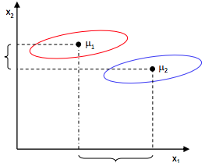
Choosing a seperator
But what about the within-class spread around the mean, the variance. How can we accommodate variance in the mean?

Slide 13


Choosing a separator
How do we measure variance (scatter)?
So we’re looking for a linear function that maximizes the function
Therefore, we are looking for a projection where examples from the same class are projected very close to each other and, at the same time, the projected means are as farther apart as possible

Slide 14
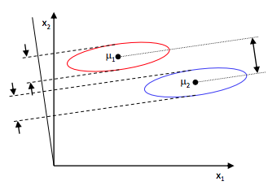
This axis maximizes separation
This axis is called the linear discriminant and is the axis along which class separability is maximized while preserving class-discriminatory information.

Slide 15
Lets take a practical example,
Curvature | Diameter | Quality
2.95 | 6.63 | Passed
2.53 | 7.79 | Passed
3.57 | 5.65 | Passed
3.16 | 5.47 | Passed
2.58 | 4.46 | Not Passed
2.16 | 6.22 | Not Passed
3.27 | 3.52 | Not Passed
We get a new chip, with curvature 2.81 and diameter 5.46, will it pass?

Slide 16
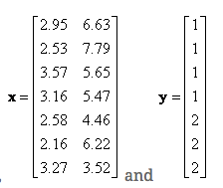
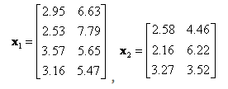


LDA Computation

Slide 17




Calculating LDA
Within class scatter is,
Or in vector form
Weighted between class scatter is
So, now we have all the parts to maximize J(W) by taking the Matrix derivative and setting J(W) to 0.

Slide 18
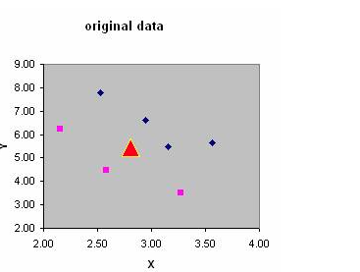
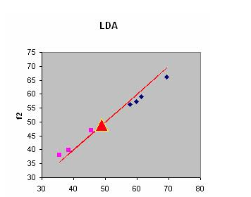
LOOK!
Notes:
To make a prediction, we would get the pooled covariance (weighted sum of added covariances), the class priors and input them into the discriminant function. We would assign observation i to the class j for which the discriminant function is largest.

Slide 19
PCA: Principal Component Analysis
PCA is an unsupervised technique. This means that, unlike LDA, it does not consider class labels.
If you recall, the goal in LDA was to computes the directions (“linear discriminants”) that will represent the axes that that maximize the separation between multiple classes
In PCA our goal is to find the directions (the so-called principal components) that maximize the variance in a dataset.
Roughly speaking, in PCA we are trying to find the axes with maximum variances where the data is most spread (within a class, since PCA treats the whole data set as one class), and in LDA we are additionally maximizing the spread between classes.

Slide 20
PCA: How to
Here are the steps for do a PCA
Take the DataFrame, ignoring the target (class)
Compute means of each dimension (feature)
Compute the covaraince matrix
Compute eigenvalues and eigenvectors
Sort eignenvector by eigenvalues
Transforming the samples onto the new subspace

Slide 21
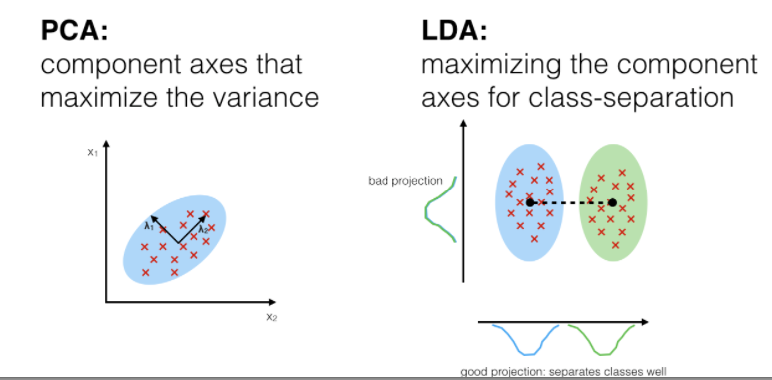
Eigenvalues, Eigenvectors???
Each dimension (feature vector) has an eigenvalue and eigenvector pair. The eigenvector gives us information about the direction of the vector (relative to other vectors) and the associated eigenvalue gives us the “length” or magnitude of the vector in that particular direction.

Slide 22
Which is my principal component?
So the eigenvector with the largest eigvenvalue is the axis or direction along which the is maximum variance.
We started with the goal to reduce the dimensionality of our feature space, i.e., projecting the feature space via PCA onto a smaller subspace, where the eigenvectors will form the axes of this new feature subspace. However, the eigenvectors only define the directions of the new axis.
In order to decide which eigenvector(s) we want to drop for our lower-dimensional subspace, we have to take a look at the corresponding eigenvalues of the eigenvectors. Roughly speaking, the eigenvectors with the lowest eigenvalues bear the least information about the distribution of the data, and those are the ones we want to drop.

Slide 23
Oh my first principal component!
So the eigenvector with the maximum eigvenvalue is my first principal component.

Slide 24
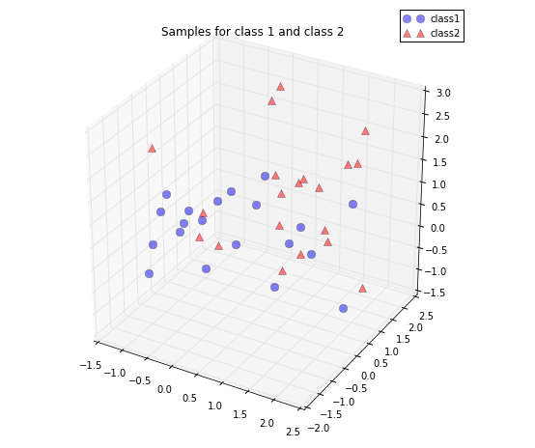
My Original feature space

Slide 25
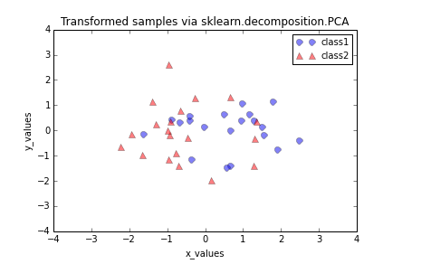
The new transformed subspace

